Slide 1
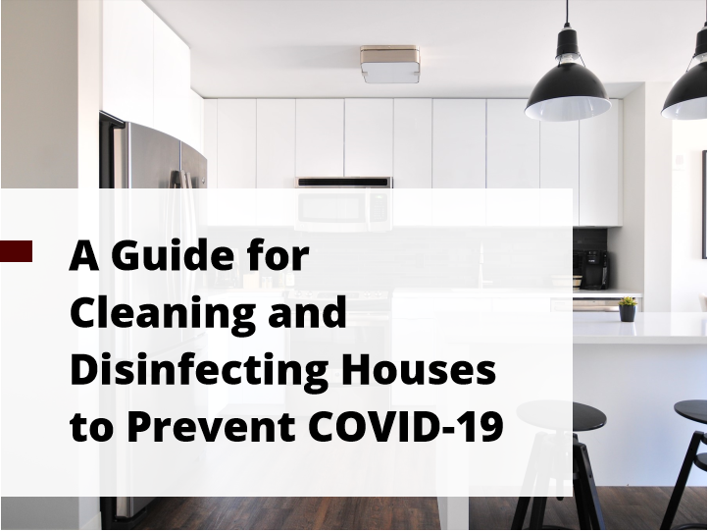

Slide 2
Notes:
TALKING POINTS:
The following presentation includes guidelines for household cleaning and disinfection, specifically in light of COVID-19. By definition, cleaning is the process of removing dirt and germs from a surface or item. Cleaning alone does not kill germs. However, this step is important as it removes as many germs as possible and helps reduce their risk of spreading. Disinfection is the process of using chemicals to kill germs on surfaces or items. Disinfection alone does not clean dirty surfaces or remove germs. Rather, this step should follow cleaning to kill germs and lower their risk of spread.

Slide 3
Notes:
TALKING POINTS:
There are preventative actions you can take if your household does not include any individuals who are suspected or confirmed to have COVID-19. First, try to clean frequently touched surfaces daily like mobile phones, tables, countertops, faucets, switches, and doorknobs using water and a regular household cleansing product. Whenever possible, you should try to clean surfaces prior to applying your disinfecting products. You should also be sure to always follow the manufacturer’s instructions for cleaning and disinfecting products.

Slide 4
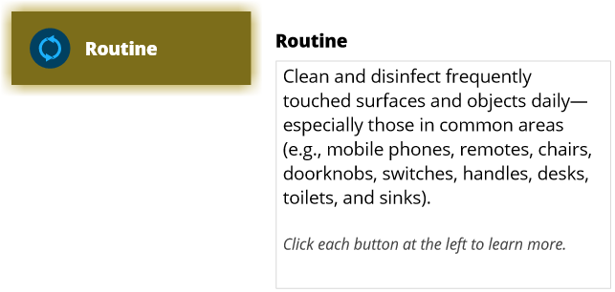
Notes:
TALKING POINTS:
This information is recommended if your household includes any individuals who are self-isolating because they are either suspected or confirmed to have COVID-19. First, clean and disinfect all frequently touched surfaces and objects on a daily basis. Be especially diligent when cleaning and disinfecting commonly used items or areas such as electronic devices, chairs, doorknobs, switches, handles, desks, toilets, and sinks. For electronic items like cell phones, tablets, remote controls, keyboards, or anything with a touch screen, you should first remove visible contamination if present. As these items can be more sensitive to cleaning and disinfecting products, it is especially important to follow manufacturer’s instructions. If you cannot find this information for your specific electronic device, consider using alcohol-based wipes or sprays containing at least 70 percent alcohol to disinfect touch screens. Dry these surfaces thoroughly to avoid pooling of liquids. You might also consider the use of wipeable covers for electronics where possible as these are more easily and safely cleaned and disinfected.

Slide 5
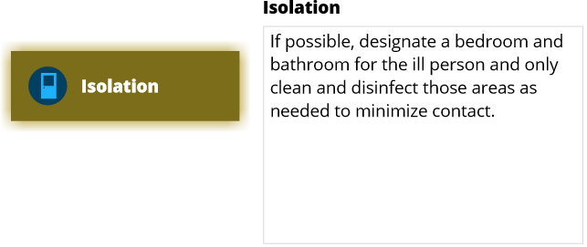
Notes:
TALKING POINTS:
If you have the available space, designate a separate bedroom and bathroom for the ill person and only clean and disinfect those areas as needed to minimize contact.

Slide 6
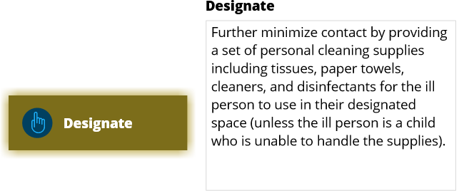
Notes:
TALKING POINTS:
In addition, you can minimize contact even further by providing a set of personal cleaning supplies including tissues, paper towels, and cleaning and disinfecting products for the ill person to use in their designated space. Note that this is only recommended if the affected individual is old enough to safely and responsibly handle the supplies.

Slide 7
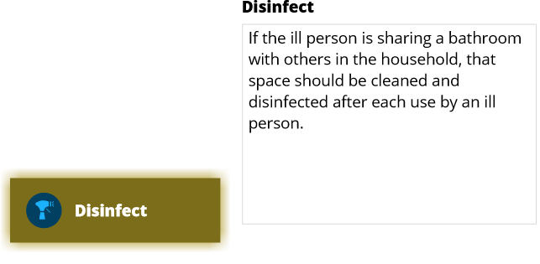
Notes:
TALKING POINTS:
If you are unable to designate a separate bathroom for ill individuals and therefore that is a shared space in the household, that bathroom should be cleaned and disinfected after each use by an ill person.

Slide 8
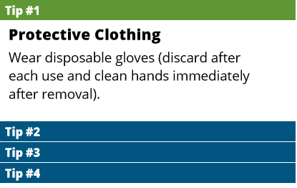
Notes:
TALKING POINTS:
The following tips should be used when cleaning and disinfecting surfaces. Tip number one is to wear protective clothing appropriate for your task. Wear disposable gloves when cleaning and disinfecting surfaces. Discard the gloves after each use and immediately wash and dry your hands thoroughly afterwards. Also, be sure there is good ventilation where you are cleaning and disinfecting.

Slide 9
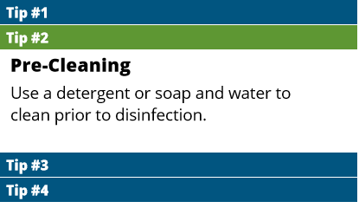
Notes:
TALKING POINTS:
Tip number 2 is to be sure and pre-clean surfaces. As previously stated, cleaning should always be your first step. Clean surfaces with your selected cleansing product and water before you begin disinfection. Remove any visible debris.

Slide 10
Notes:
TALKING POINTS:
Tip number 3 is to be sure to select effective disinfecting products. There are a ton of products on the market so it can be difficult to choose one that is appropriate for killing viruses like the one that causes COVID-19. Diluted bleach solutions and most Environmental Protection Agency-registered household disinfectants should be effective. To see if your specific disinfectants meet the EPA’s criteria for use against the novel coronavirus, you should visit www.epa.gov and search for “List N: Disinfectants for Use Against SARS-COV-2”.

Slide 11
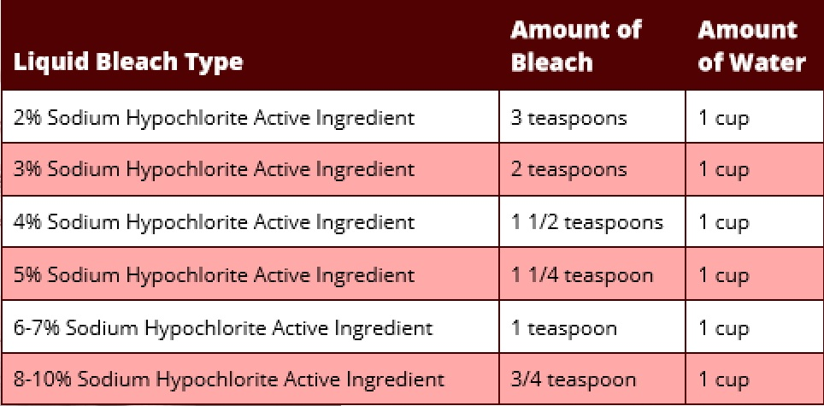
Notes:
TALKING POINTS:
To disinfect surfaces in your home with bleach, you will need to make a bleach solution by mixing your bleach with cool tap water. Be sure to purchase a plain, unscented bleach which has the percentage of sodium hypochlorite, the active chemical in bleach, clearly labeled on the container. Concentrations for plain bleach can vary between 2 and 10 percent sodium hypochlorite. You can determine the percentage by looking on the container’s packaging. This information will help you mix an effective disinfecting solution. For example, if your bleach has 3 percent sodium hypochlorite, you should add 2 teaspoons of water for every 1 cup of water when mixing your solution. If your bleach has 6 to 7 percent sodium hypochlorite, you should add 1 teaspoon of bleach for every 1 cup of water in your solution. Both of these mixtures will yield the 0.12 percent bleach solution that the Centers for Disease Control and Prevention recommends for disinfectant use. This table can be used as a guide for mixing a solution based on the amount of sodium hypochlorite in your bleach product. Avoid “splashless” bleach or other types of laundry bleach which does not indicate the concentration of sodium hypochlorite. These have not been confirmed to be effective disinfectants. You should also never mix household bleach with ammonia or other cleansers. And, be sure to double check your product’s expiration date because expired bleach will not be as effective at killing coronaviruses like the one that causes COVID-19. Follow the manufacturer’s instructions for application and ensure the contact time (or the time a surface is required to stay wet in order for germs to be effectively killed) is at least one minute. Finally, whenever using bleach, be sure to allow for proper ventilation both during and after application.

Slide 12
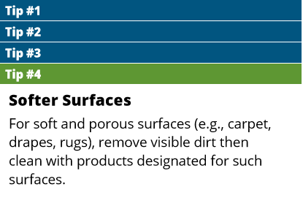
Notes:
TALKING POINTS:
Tip number 4 considers soft and porous surfaces like carpeting, drapes, and rugs. First, you should remove any visible dirt and then clean with products designated for use on such surfaces. If possible, after removing visible dirt, you can launder these items in accordance with the manufacturer’s instructions. Use the warmest appropriate water settings and dry items completely. Continue to the next slide for more information on effective laundering.

Slide 13
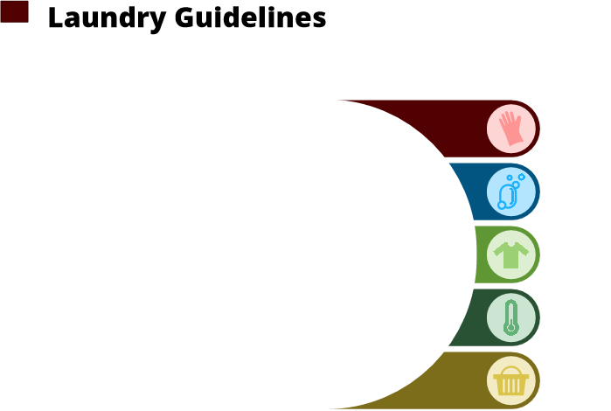
Notes:
TALKING POINTS:
This slide focuses on guidelines for laundering linens, clothing, and any other items that go in the laundry. First, you should wear disposable gloves when handling laundry from a sick person and discard the gloves after use. Wash and dry your hands thoroughly after removing your gloves.

Slide 14
Notes:
TALKING POINTS:
If you do not have gloves, you should wash your hands immediately after handling dirty items.

Slide 15
Notes:
TALKING POINTS:
Be sure not to shake dirty laundry. This action could spread virus particles through the air and increase the risk of spread.

Slide 16
Notes:
TALKING POINTS:
Aim to wash items using the warmest appropriate water setting and dry them completely. Note that it is safe to wash items from a sick person together with items from others in the household, even those who are healthy or not showing any signs of illness.

Slide 17
Notes:
TALKING POINTS:
Finally, do not forget to clean and disinfect your hampers, too. Follow previous guidance for cleaning surfaces or consider using a hamper liner that can either be laundered or thrown out.

